Slide 1
ENSE 470, Milestone 7
ByteThis Software
Taylor Petrychyn, Alwin Baby, and Konstantin Kharitonov
April 12, 2018

Slide 2
Dancing to Zebras

Slide 3
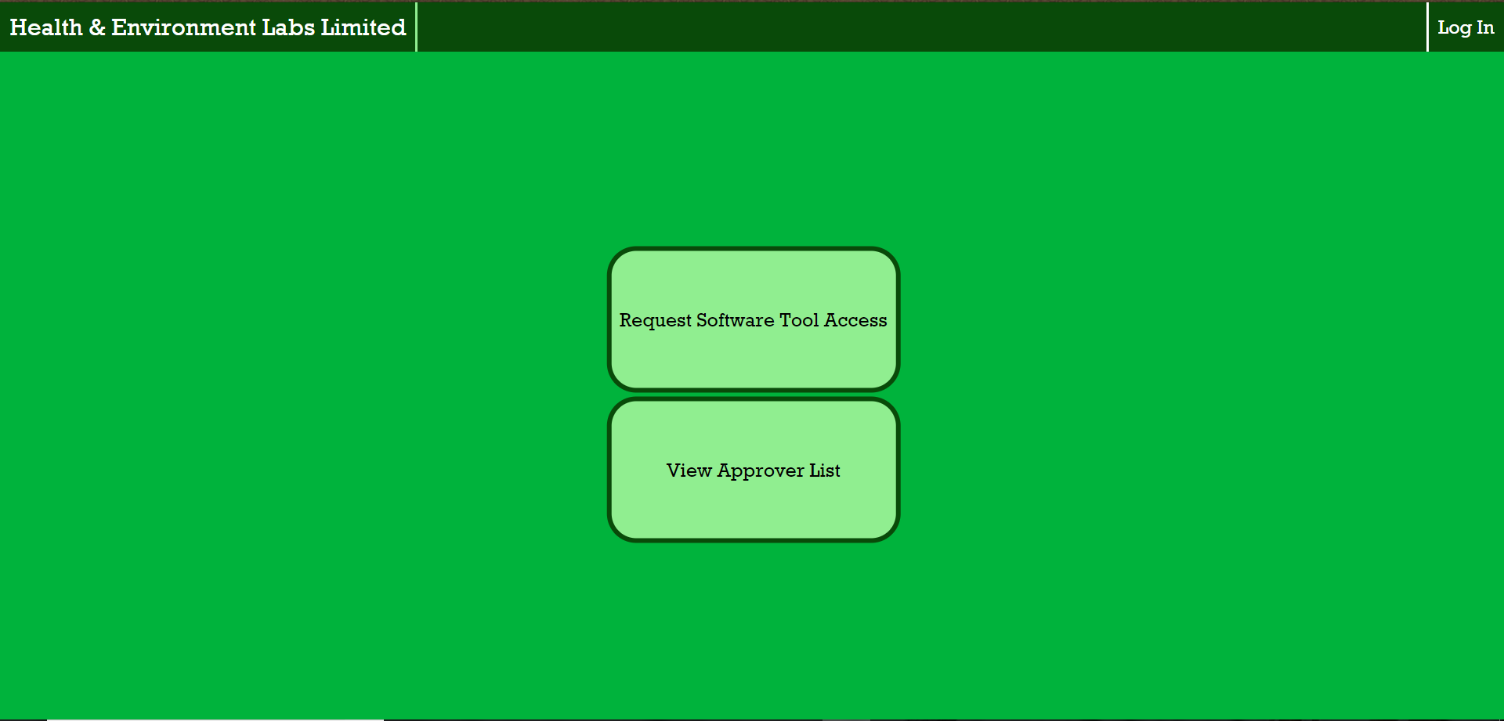

Slide 4
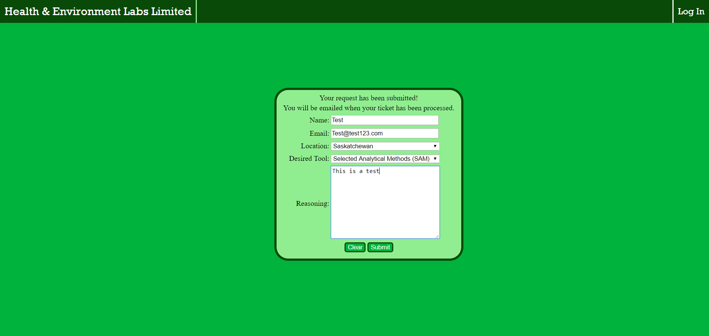

Slide 5
Team GitHub review
GitHub was readable and easy to understand
All the files were clearly named
Will be very easy to pickup where left off

Slide 6
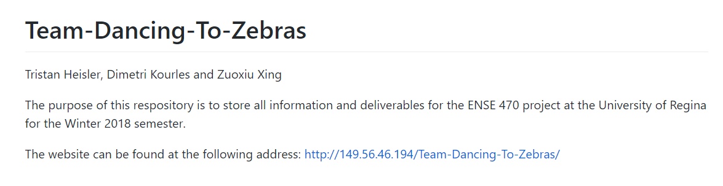
README file

Slide 7
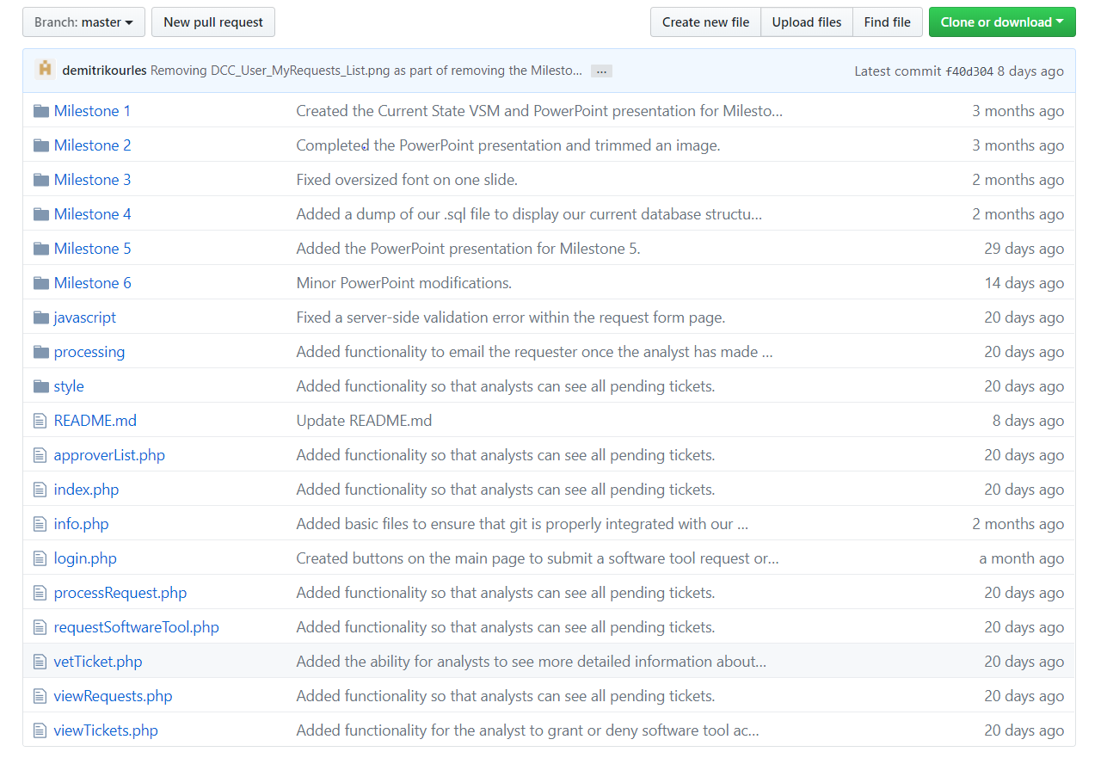

Slide 8
Refactor review (High-level focus)
Code
  PHP, MySql, Easy to read and understand
ATDD tests
  19/19 Test Cases Passed
  Example, Single Request Input method
Code Issues -> Solutions
  Repeated Database Connections ($connection) -> Singleton
  Navigation Bar code repeated on each page -> Composite
  Unclear/1 letter Query Parameter names -> Give names
  Table rows styled with PHP logic -> CSS nth-child selector
  Form Validation repeated -> Re-useable functions
  Unsafe Font: Rockwell -> Font-family

Slide 9
Design pattern discussion (High-level focus)
Design Patterns
  Decorator: Navigation Bar
    Allows different links for different user types
    Could access features without needing a login
  State: Query Params
    Passing state through the url allows alerts to be shown/hidden accordingly
  Ticket Submission
    Allows for the user to submit their to be notified when ticket is submitted

Slide 10
Reviewed team’s response
Questions?

Slide 11
Group reflection
How did you feel about this milestone? What did you like about it? What did you dislike?
  There was a lot of code reading.
  Dislike - We failed to break the webpage
What did you learn about yourself as you collaborated and worked through this milestone?
  Reviewing isn’t as hard as we thought
How will you use what you have learned going forward?
  Be able to evaluate our own projects for code smells

